Slide 1
Climate-mediated models of Western Atlantic Bluefin Tuna spatial density

Slide 2
Goals
Apply spatial-temporal models to develop improved indices of abundance for the western BFT stock
Apply VAST modeling to US-only large BFT data, making use of concurrently-developed VAST model of prey density
Apply VAST modeling to joint US-Canadian large BFT data, cannot use prey density as a covariate due to lack of data

Slide 3
Outline
VAST basics
The data
Considerations for using our data in VAST
Results
Data storage and management

Slide 4
VAST Basics
Vector Autoregressive Spatio-Temporal Model (VAST)
Designed to estimate spatial variation in density of one or more categories in one or more time steps.
Notes:
Objectives: map spatial density, generate indices of abundance, identify habitat associations, identify shifts in spatial dynamics

Slide 5
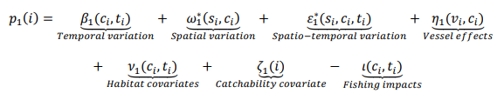
VAST Basics
Predictor 1: Model encounter probability at every spatial location and time step for each category
Predictor 2: Model positive catch rate (abundance) at every spatial location and time step for each category, based on the calculated encounter probability
Notes:
Spatial delta-generalized linear mixed model for multiple categories

Slide 6
VAST outputs
Maps of spatio-temporal density
Indices of abundance for whole area and selected spatial strata
Stock centers of gravity
Stock range edges
Effective area of utilization (area needed to contain population at average spatial density for the spatial domain)
Marginal effects of density covariates on presence/absence and positive catch rate
Relative importance of density covariates to predicting stock center of gravity

Slide 7
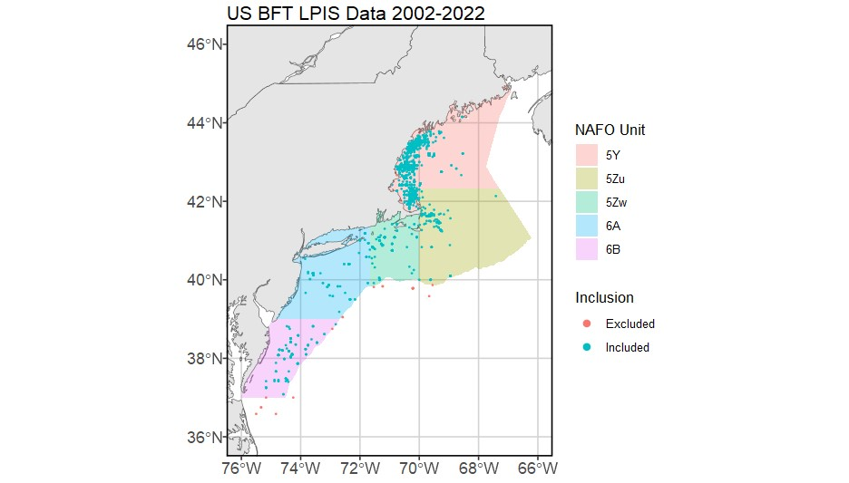
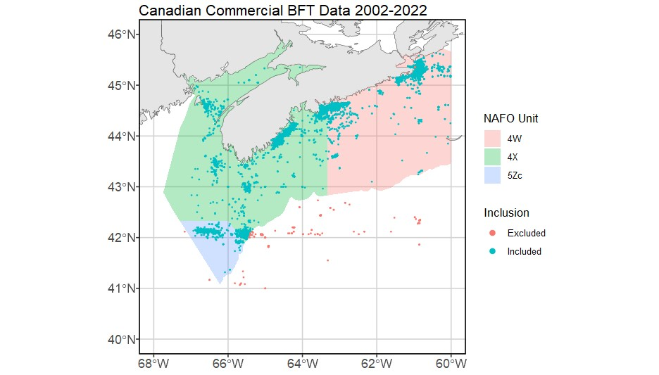
US and Southwest Nova Scotia data
-Rod and reel
-Recreational
-Survey
-Rod and reel, harpoon, tended line
-Commercial
-Logbook

Slide 8
Data considerations
Decided to make both US-only models and joint US-Canadian models
Fleet behavior, data volume, size of fish caught wildly different between flags
US data volume for 0 catch is low, missing spatial attributes
Prey spatio-temporal density in Canadian waters unattainable
Collaborators from DFO making their own Canadian-only models
Both for SWNS and joint SWNS-Gulf of St Lawrence
Completed in Oct 2023
Canadians had to use hierarchical clustering to determine time at sea, time spent fishing for many records

Slide 9
US-only, large fish-only models

Slide 10
Peeking at the data
Samples between the Chesapeake and Hatteras (NAFO area 6C) excluded, too few to be representative
Samples offshore from the continental margin excluded, too few to be representative
Not a big data loss– around 25 samples

Slide 11
Model structuring – domains
Spatial domain: Gulf of Maine ONLY (NAFO Unit 5Y)
GOM represents 80% of all BFT effort in US waters
Temporal domain: 2002-2022
Too few unsuccessful fishing efforts recorded prior to 2002
Results from 2022 have excessively poor fit: huge confidence intervals and dramatically different results given trends of prior five years
Choosing to include 2022 in model but not interpret results from this year due to low confidence in realism of results
Potential fix is adding 2023 data (in the works)

Slide 12
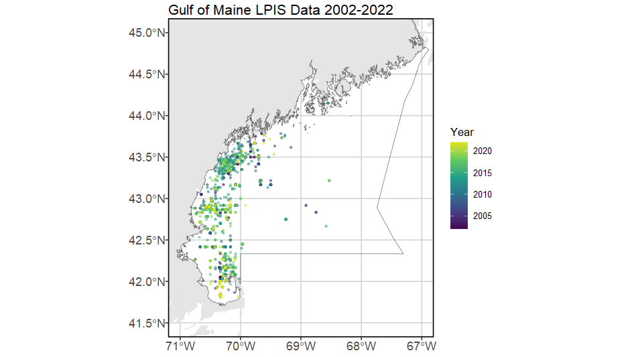
Model structuring – domains
Notes:
Gulf of Maine only (area has 80% of coastwide US effort). Temporal domain 2002-2022. No samples east of 69deg. No samples from June or July 2020 (no observer coverage to make prey model for this period, and VAST cannot handle missing values in density covariates). Looking to incorporate 2023 data with completion of new prey VAST model. Data from 2022 included, fitted, but not interpreted in results due to excessively poor fit.

Slide 13
Model structuring – data inputs
Number of fish caught = response
Do not have biomass information for every fish, must use abundance instead
Fishing hours (time spent explicitly fishing, not steaming) = effort
Number of lines as catchability covariate for both linear predictors
Thinking that more lines in the water likely affects both likelihood of encountering fish AND the positive catch rate.
Have to remove like 12 samples that have missing # of lines data

Slide 14
Model structuring – spatio-temporal variation
No geometric anisotropy – fails to converge when turned on
Indicates equal rate of change across alongshore and offshore axes
Caused by limited spatial extent covered by samples, infrequent capture of multiple fish, and/or highly migratory nature of the fish?
1st linear predictor (presence/absence)
Prey, SST, AMO, bathymetry used as density covariates
NAO dropped (no noticeable effect)
Temporal structure (random walk) of spatiotemporal variance, fixed effects for each year’s intercept
2nd linear predictor (positive catch)
No spatial or spatiotemporal variation (too few times where >1 fish caught)
Temporal variation is a random effect independent for every year

Slide 15
Density covariate updates
SST
¼ deg spatial resolution, daily timestep
Depth
GEBCO 15 arc-second interpolated grid
AMO
Monthly timestep
Prey
Spatiotemporal density from VAST model using observer data inputs, monthly timestep

Slide 16
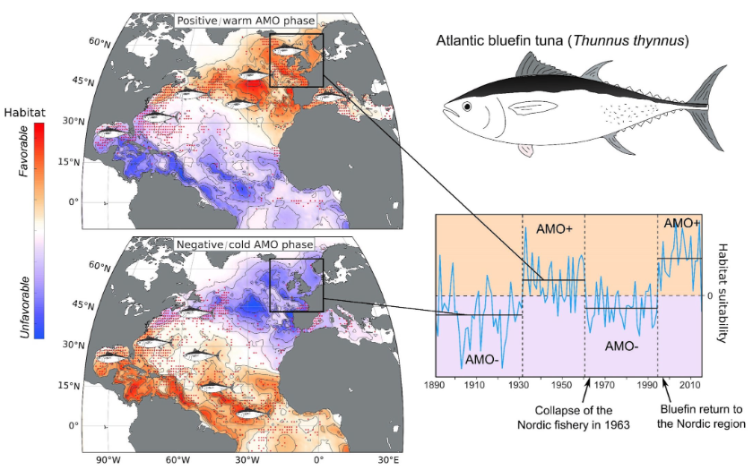
Sidebar: AMO
Adapted from Faillettaz et al. (2019)
Notes:
The problem with AMO: it should have a greater effect but every year included in this model is a “positive phase” year. We have limited contrast to notice an effect. Strongest annual AMO signal for the entire time series is in 2022, weakest in 2002.

Slide 17
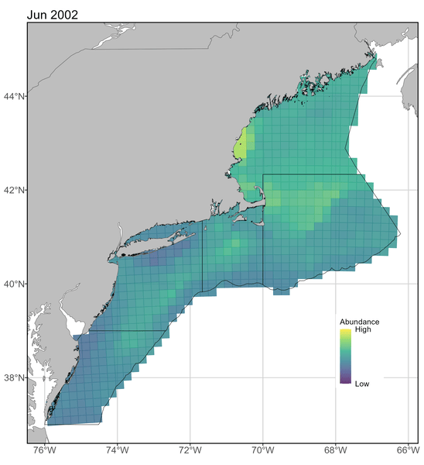
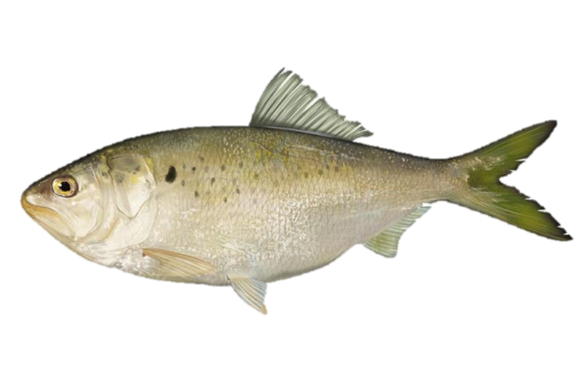
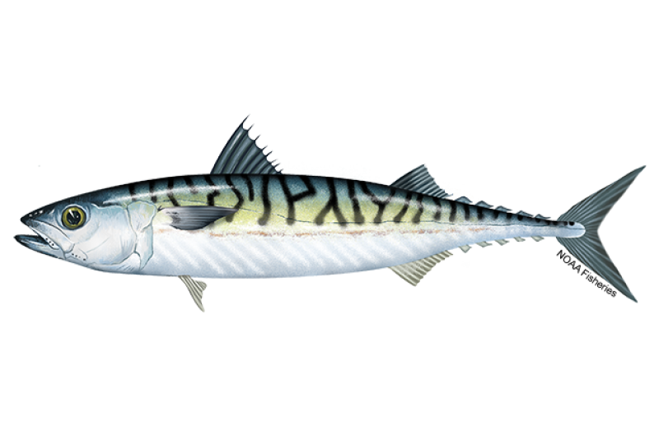
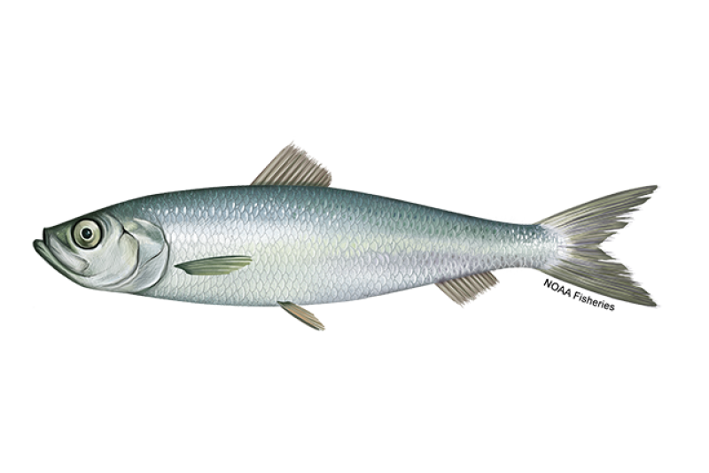
Sidebar: prey
NOAA observer data for all trips reporting menhaden, mackerel, or herring catch
Modeled at monthly time step in every tuna season (June-Oct) 2002-2022
Missing June and July 2020 because COVID, necessitates dropping tuna modeling in those periods
Extracted spatial density (fish per km^2) in each grid cell, assigned that value as prey availability to all tuna samples in that cell.
Cells same dimensions as tuna model
Probably worth a whole paper on its own, will ignore intricacies for now

Slide 18
How density covariates are incorporated to VAST
Basically like a GAM
Penalized, smoothed polynomials reflecting the relationship of the covariate to each of the two linear predictors (presence/absence, positive catch)
Natural splines
Allows for piecewise polynomial relationships across the bulk of the data but force linear relationships at the min/ max bounds.
Reduces unrealistic relationships due to low sampling density at min/ max bounds.

Slide 19
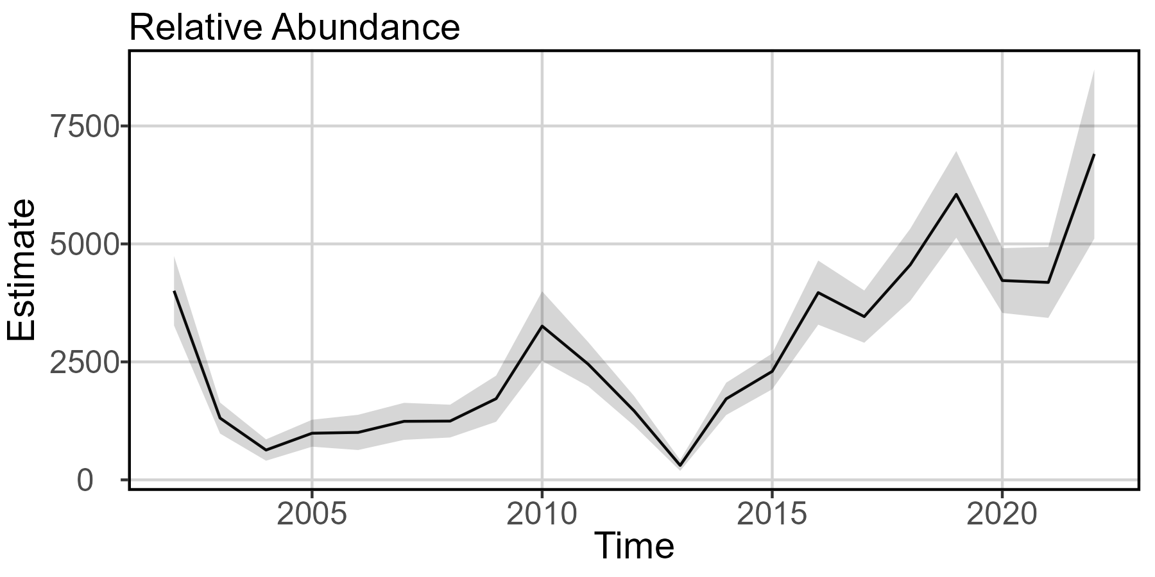
Indices of relative abundance
Notes:
Local minima at 2004 and 2013, local maxima at 2002, 2010, 2019. Results at 2022 should not be interpreted.

Slide 20
Index of relative abundance takeaways
Ecological meaning
Matching trends of this model and Alex Hansell’s entire US-coast model regardless of differing spatial extents highlights how GOM is the driver of US BFT abundance
What caused the rapid drop at 2013?
Continuation of decline beginning in 2010?
“Wicked Tuna Effect” after new entrants from 2012 premiere?
Lagging disturbance effect of massive marine heatwave in 2012?
Management practices in the Med leading to fewer cross-Atlantic migrants?

Slide 21
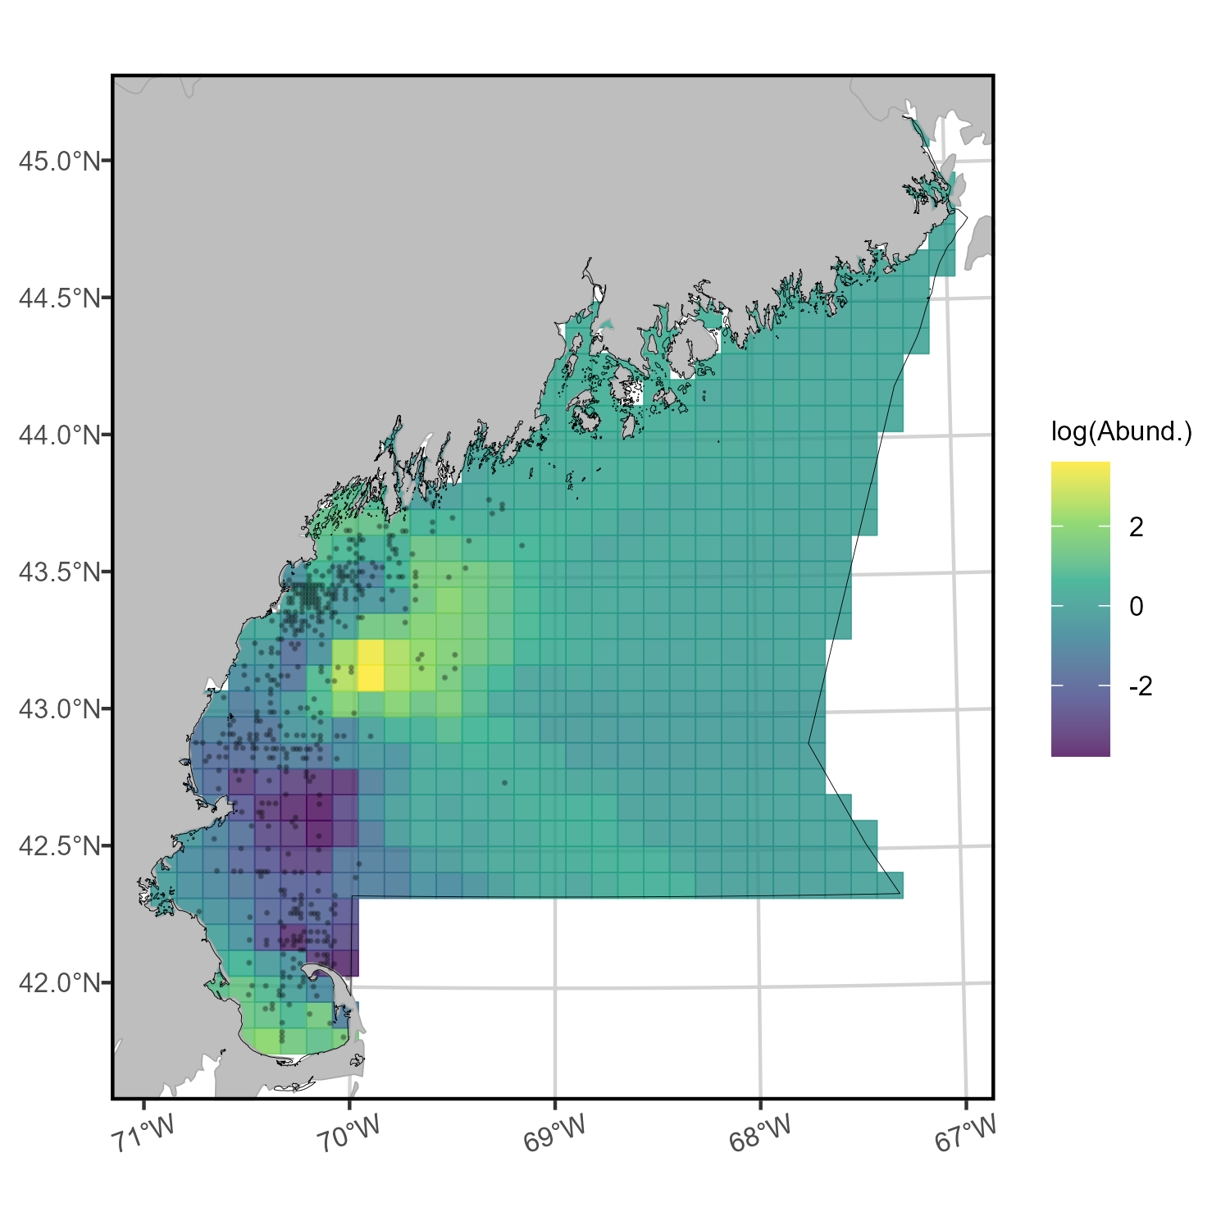

Mapping spatial density
Difficult to assess
abundance within
area east of 69°,
low confidence.
Persistent hot spot
Scaled
log(Abund)
Persistent cold spot
Notes:
Temporal maps of density also provided to you in separate file. Is too small for detail on ppt slide.
This plot is SUMMED SPATIAL DENSITY. Or, the cumulative relative abundance of fish within each grid cell, summed over time.
Grid cells are 22km by 22km

Slide 22
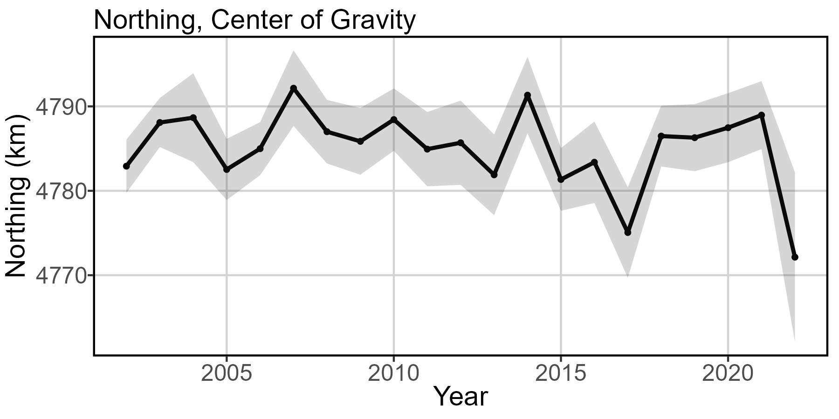
Center of gravity
North
South
Notes:
Model with GMRF, spatial and spatio-temporal effects turned on for linear predictor 1 (off for 2), temporal effects for both linear predictors, all chosen density covariates.
Low confidence in results from 2022, recommend including data in model development but no interpretation of results in this year.

Slide 23
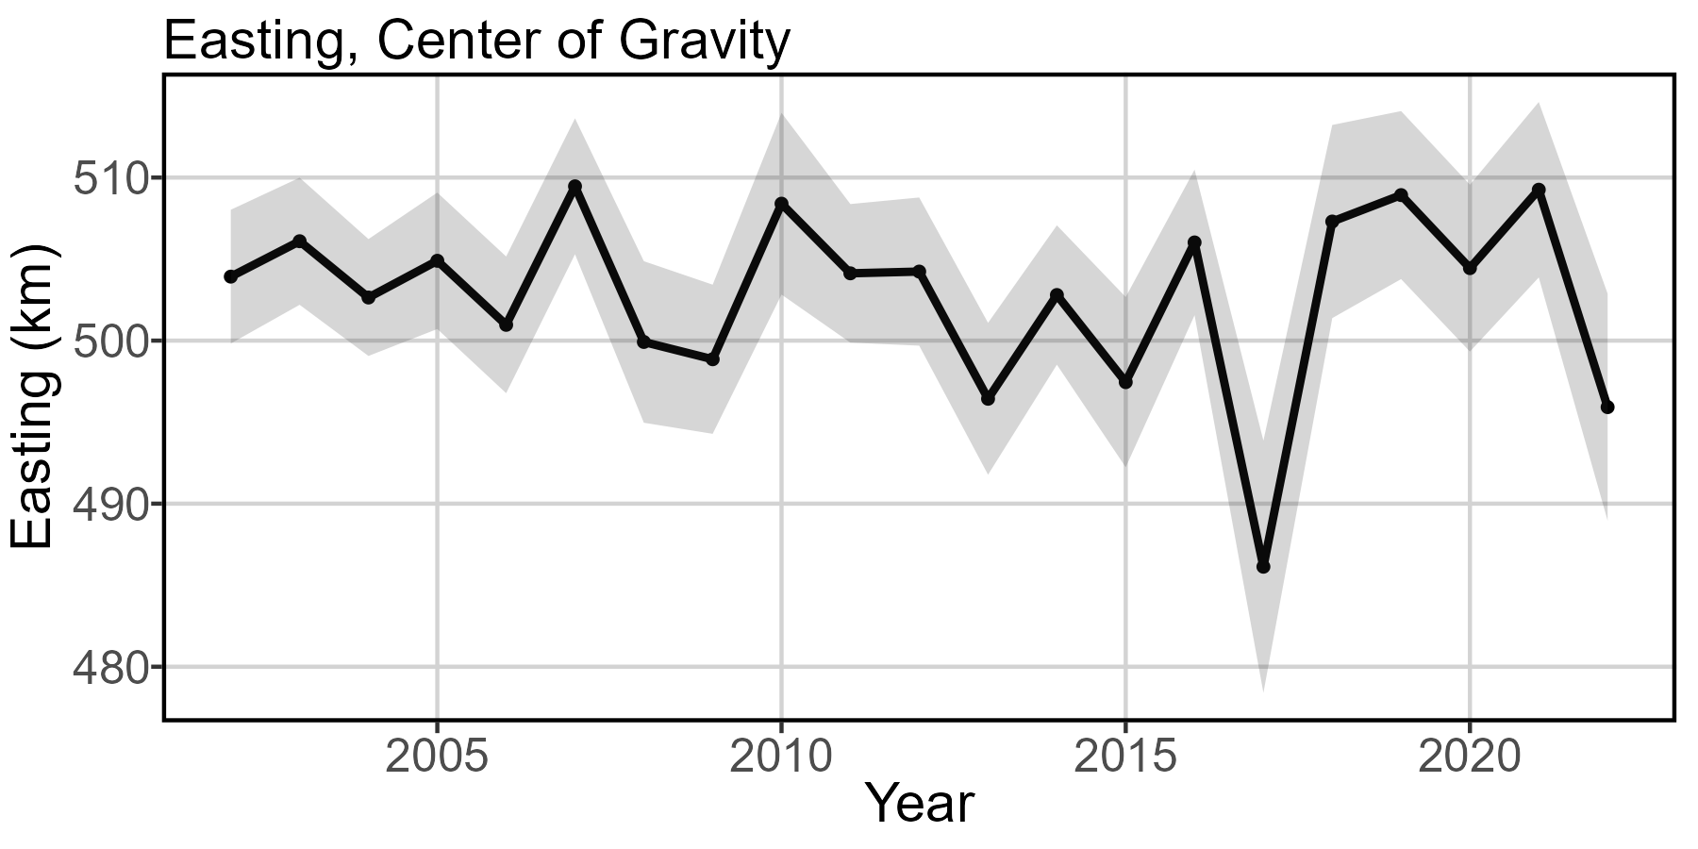
Center of gravity
East
West
Notes:
Model with GMRF, spatial and spatio-temporal effects turned on for linear predictor 1 (off for 2), temporal effects for both linear predictors, all chosen density covariates.
Low confidence in results from 2022, recommend including data in model development but no interpretation of results in this year.

Slide 24
Center of gravity takeaways
Ecological meaning
Fish, fishers, or both are condensing into the near-coastal region of GOM between Gloucester and Portland
Model results could reflect a shift in spatio-temporal effort distribution and intensity more than spatio-temporal changes in BFT productivity or distribution
Dip in 2017: probably driven by unusually high hours-per-catch at Fippennies Ledge, artificially shrinks range inshore. Also notable: SST anomalously cold in 2017 as compared to the rest of the time series.
Doesn’t look like spatial availability (e.g.: fish moving to Canadian waters or way offshore) dipped for American fishers much over this period

Slide 25
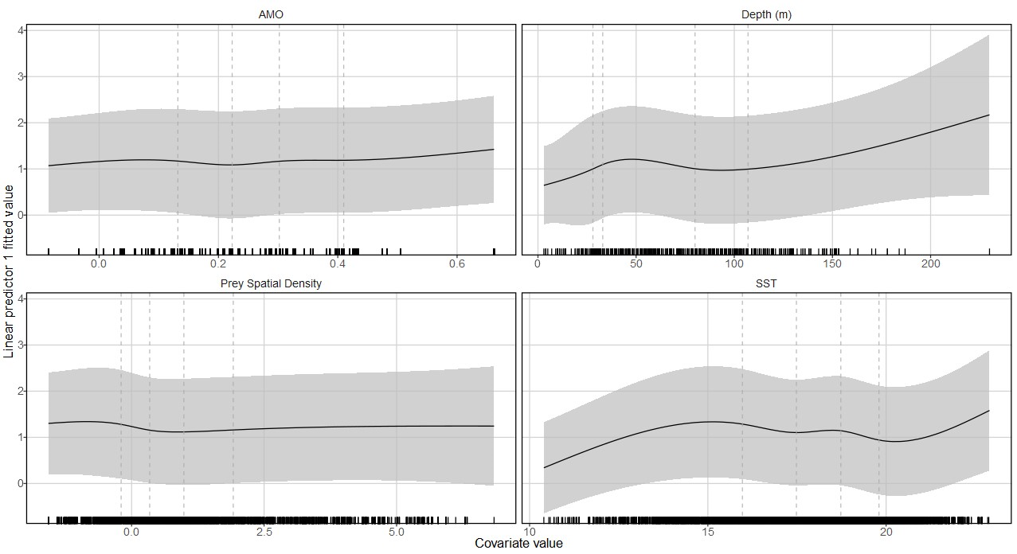
Density Covariate Marginal Effects
Notes:
Dashed vertical lines are where internal knots are placed (0.2, 0.4, 0.6, 0.8 quantiles).
A problem: 2022 data included in this result. Cannot really be parsed out.
All marginal effects shown are for first linear predictor (presence/absence)
Increasing AMO strength increases presence likelihood, near-linear
Depth relationship hard to assess given strong nearshore feature preference of fishermen. Unsure if presence increases with depth to this degree after ~105m.
Very limited effect of prey density. Likely that the prey model “soaks up” spatio-temporal effect of SST on prey, though pre-modeling checks don’t show correlation. Probably not much new in this density covariate.
Unsurprisingly, low and high SST translate to absence of BFT. Exponential increase in presence between 80% quantile and max SST probably not realistic. Local maxima at about 16°C.

Slide 26
Density covariate marginal effects takeaways
Ecological meaning
All marginal effects shown are for first linear predictor (presence/absence)
Increasing AMO strength increases presence likelihood, near-linear
Depth relationship hard to assess given strong nearshore feature preference of fishermen. Unsure if presence increases with depth to this degree after ~105m.
Very limited effect of prey density. Likely that the prey model “soaks up” spatio-temporal effect of SST on prey, though pre-modeling checks don’t show correlation. Probably not much new in this density covariate.
Unsurprisingly, low and high SST translate to absence of BFT. Exponential increase in presence between 80% quantile and max SST probably not realistic. Local maxima at about 16°C.
Notes:
Higher likelihood of presence at low prey density: are they biting because they’re hungry?

Slide 27
Overall
Abundance
Rapid drop in abundance 2010-2013, recovery since 2013
Center of gravity
Average annual center of gravity change is slight southwestward shift, tuna spatial availability relatively stable over time
Density covariates
Major driver is SST. Non-linear relationship between presence/absence and SST, with local peak presence rate at around 16C.
Obvious increase in SST through study spatiotemporal domain (avg 0.08 deg/yr). Also obvious increase in abundance through same temporal domain. Are BFT more adaptable to warmer water than we expect?
Prey didn’t have much of an effect because we’d have to be super-fine temporal and spatial resolution to truly capture overlaps in distribution. And because prey distribution is likely HIGHLY affected by SST, and we already have effects of SST in the model. They don’t shake out to statistically be co-linear, but we probably aren’t getting any new information here.

Slide 28
Thoughts
Looking coastwide and prior to 2002, we know that large BFT are targeted and captured less frequently in areas south of Georges Bank than they used to be
AMO may play a role in structuring this distribution shift
Focusing instead on GoM (where 80% of recorded effort occurs), spatial shifts are slight in our time series
Moving on to joint model will allow us to widen spatial scope and get a better grasp on large-scale spatial dynamics

Slide 29
Joint US-Canadian, large fish-only models

Slide 30
Model structuring – domains
Temporal domain: 2002-2022
Same as US only model. Previous model used 1996-2019, which is all overlapping data. We exclude data prior to 2002 due to lack of reported unsuccessful trips (no catch)
Spatial domain: US-Canadian continental shelf waters.
Plus 10km buffer to offshore edge of continental shelf, trying to keep in fishing trips made in canyons on the edge.
Southern tip at mouth of Chesapeake (NAFO Unit 6B), northern tip at intersection of Nova Scotian coastline and 60°W (NAFO Unit 4W).
Encompasses all data, no areas are dropped.
Results also reported at level of spatial strata: US waters and CA waters.

Slide 31
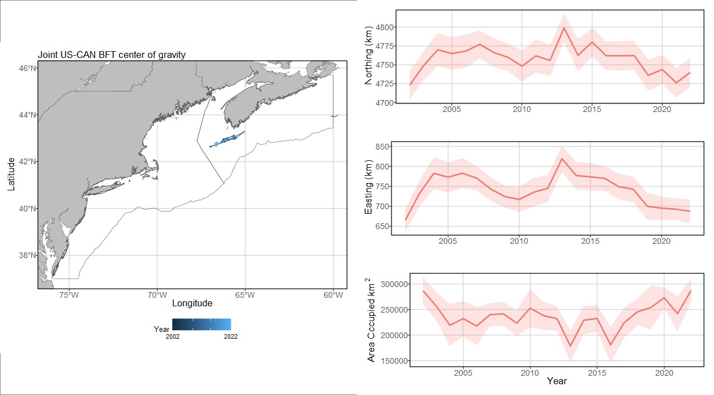
Model structuring – domains
Joint US-CAN BFT model spatial strata

Slide 32
Model structuring – data inputs
Number of fish caught = response
Do not have biomass information for every fish (US limitation), must use abundance instead
Fishing hours (time spent explicitly fishing, not steaming) = effort
I converted Canadian time at sea to fishing hours in the joint model
Country-gear combination as vessel effect
Thinking that catchability is likely grouped by flag and gear, with random variation within the groupings.
Can’t use # of lines as a catchability covariate because Canadian harpoon fishery is included in this model– does not use lines.

Slide 33
Model structuring – spatio-temporal variation
Geometric anisotropy used
Indicates directionally-variant rate of change
Greater degree of similarity along NW-SE axis than any other direction.
Least degree of similarity along SW-NE axis.
1st linear predictor (presence/absence)
SST, AMO, bathymetry used as density covariates. No prey.
NAO dropped (no noticeable effect)
Temporal structure (random walk) of spatiotemporal variance, fixed effects for each year’s intercept
2nd linear predictor (positive catch)
Same as 1st linear predictor

Slide 34
Density covariates
SST
Old: no data source provided, assume same as US model
New: ¼ deg spatial resolution, daily timestep
Depth
Old: no data source provided, but dropped from final model
New: GEBCO 15 arc-second interpolated grid
AMO
Old: not included
New: Monthly timestep
Prey
Never got Canadian prey data, could not make a model for inclusion here.
Notes:
The problem with AMO: it should have a greater effect but every year included in this model is a “positive phase” year. We have limited contrast to notice an effect. Strongest annual AMO signal for the entire time series is in 2022, weakest in 2002. At least with Canadian fishing extending into December we have a slightly greater range of values.

Slide 35
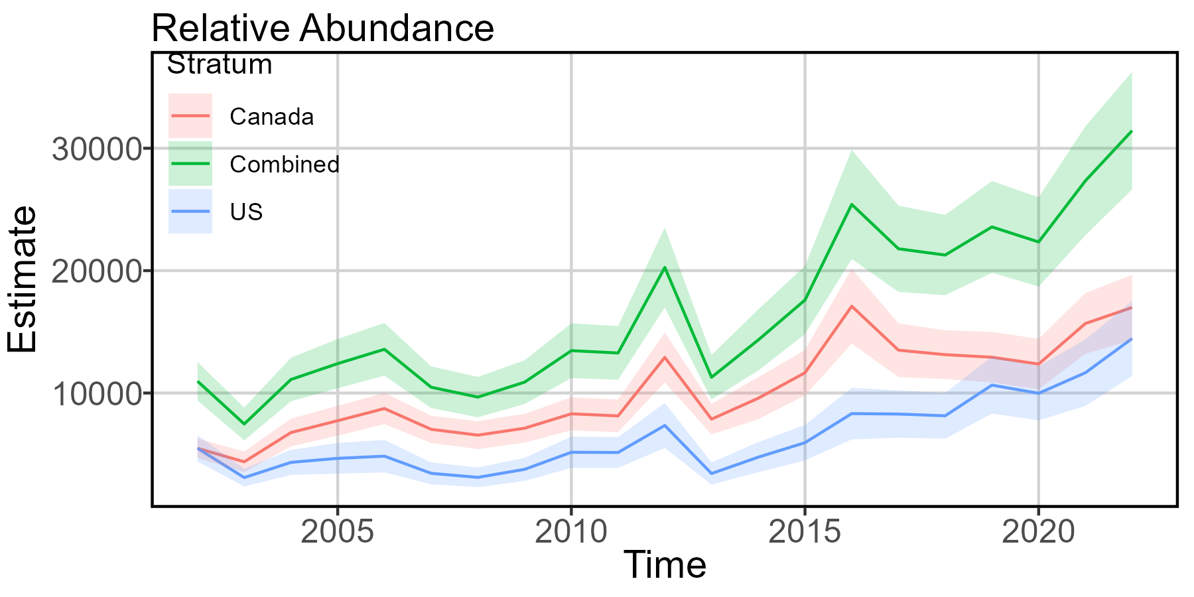
Indices of relative abundance

Slide 36
Indices of relative abundance takeaways
Results
Quick drop in rel abundance for all strata in 2013. General increase in rel abundance since 2014.
Ecological meaning
US relative abundance higher than SWNS rel abundance only in 2002 (during model spatial domain, 2002-2022). This could be related to AMO strength, as we shifted from cold to warm phase in the late 90s and it took a few years for the effect to get “up to strength.” Wouldn’t put too much stock in actual numbers, US LPS data much less compelling than Canadian commercial data.
Since 2014, US index of relative abundance has grown at a steadier rate than more variable SWNS index.

Slide 37
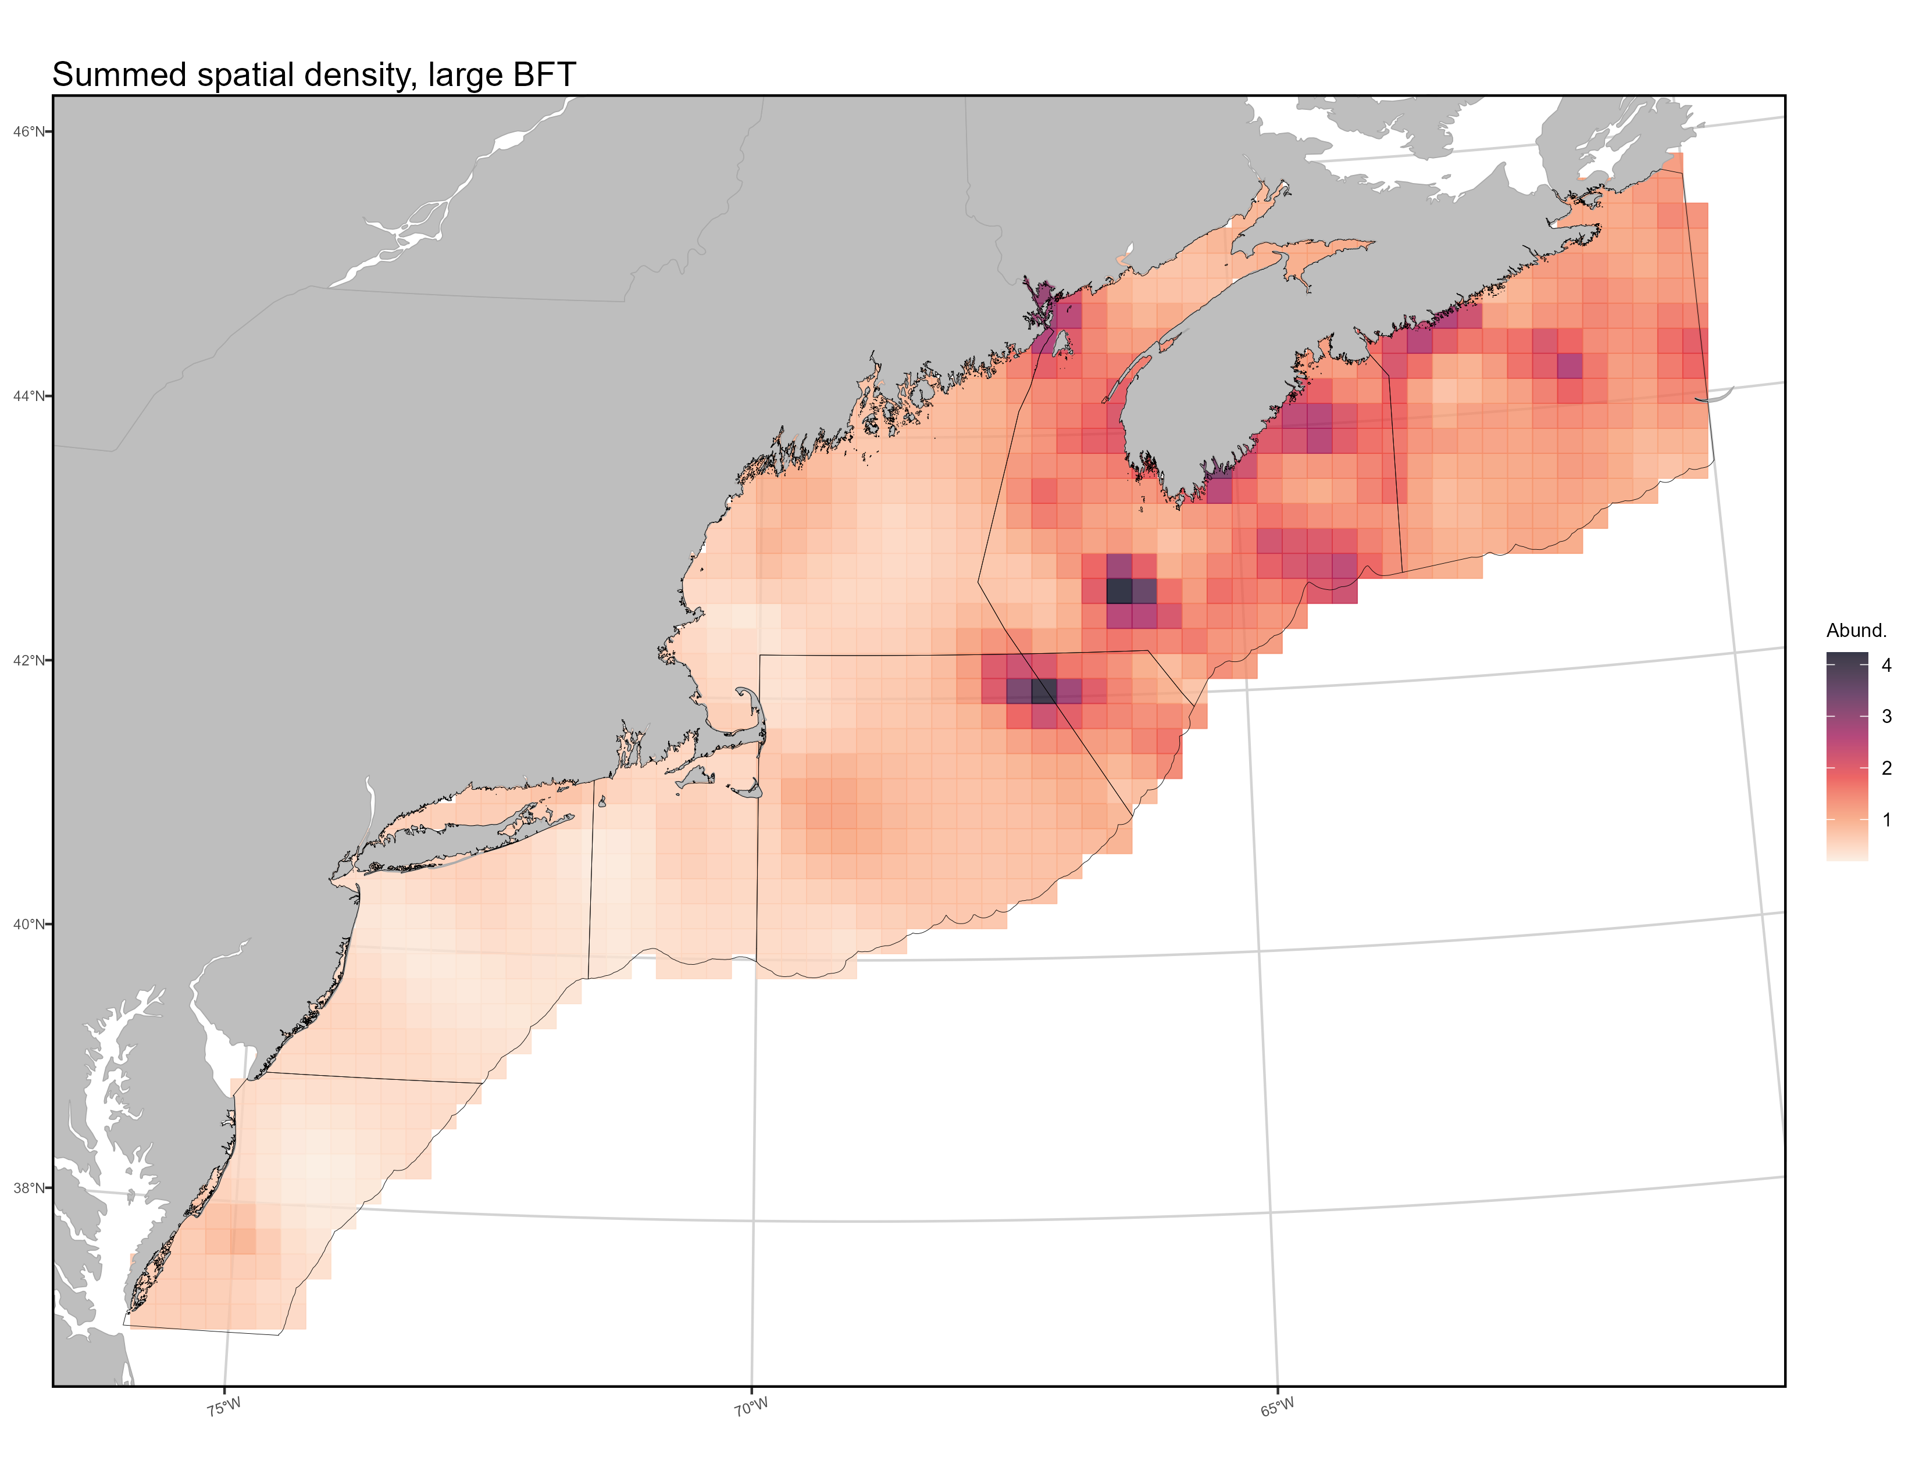
Mapping spatial density
Temporal shift in
hot spot from
Brown Bank to
Georges Bank
Persistent cold region
Notes:
Temporal maps of density also provided to you in separate file. Is too small for detail on ppt slide.
This plot is SUMMED SPATIAL DENSITY. Or, the cumulative relative abundance of fish within each grid cell, summed over time.
Grid cells are 22 km by 22km, I increased ncells to keep similar spatial resolution though our spatial domain basically quintupled from just the Gulf of Maine

Slide 38
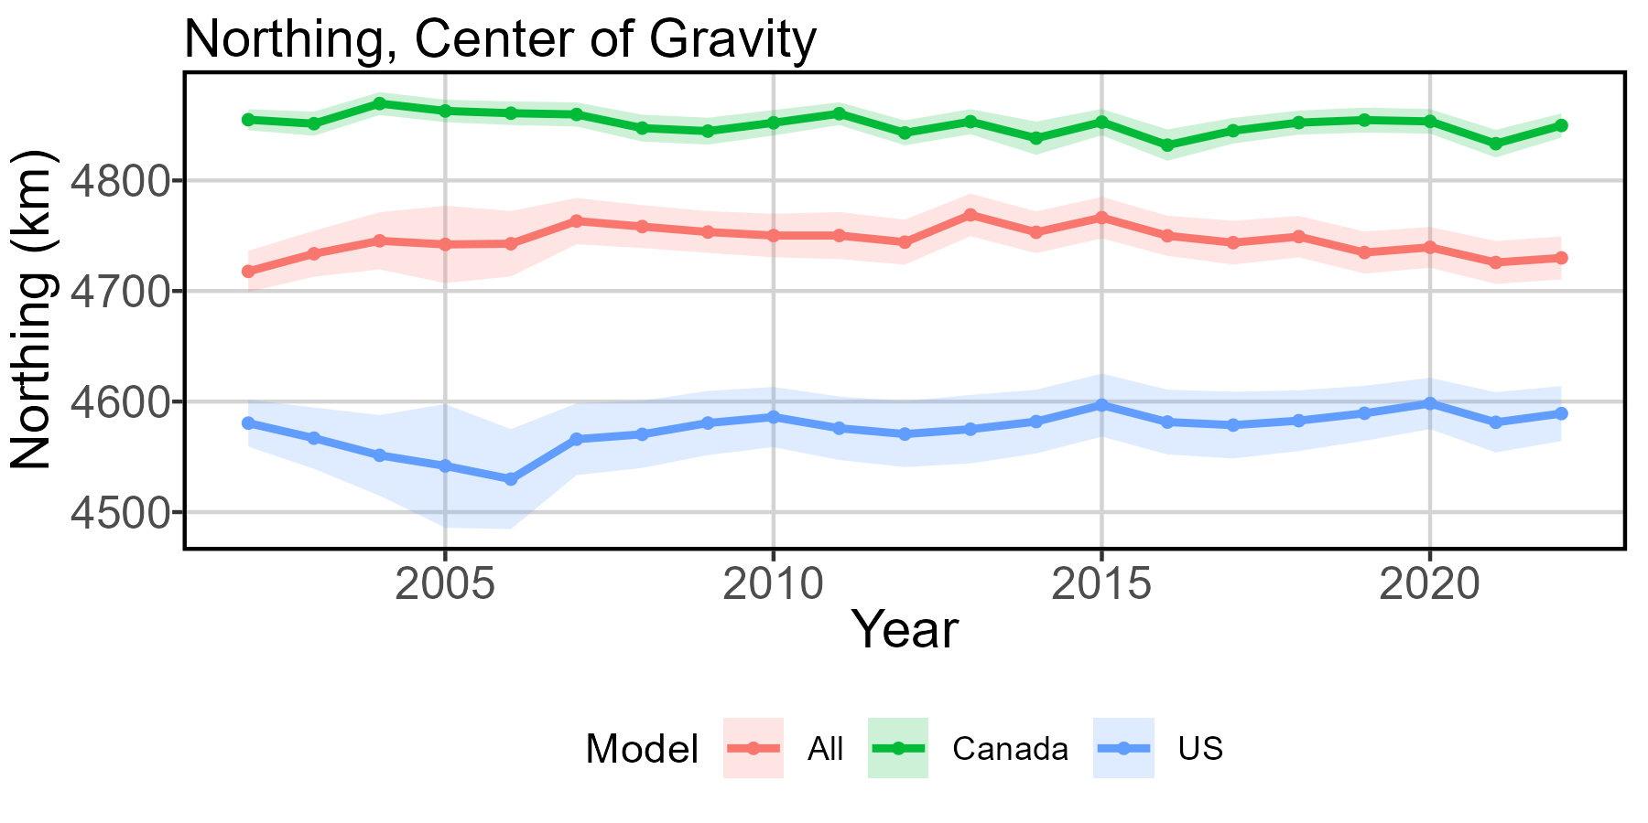
Center of gravity - strata

Slide 39
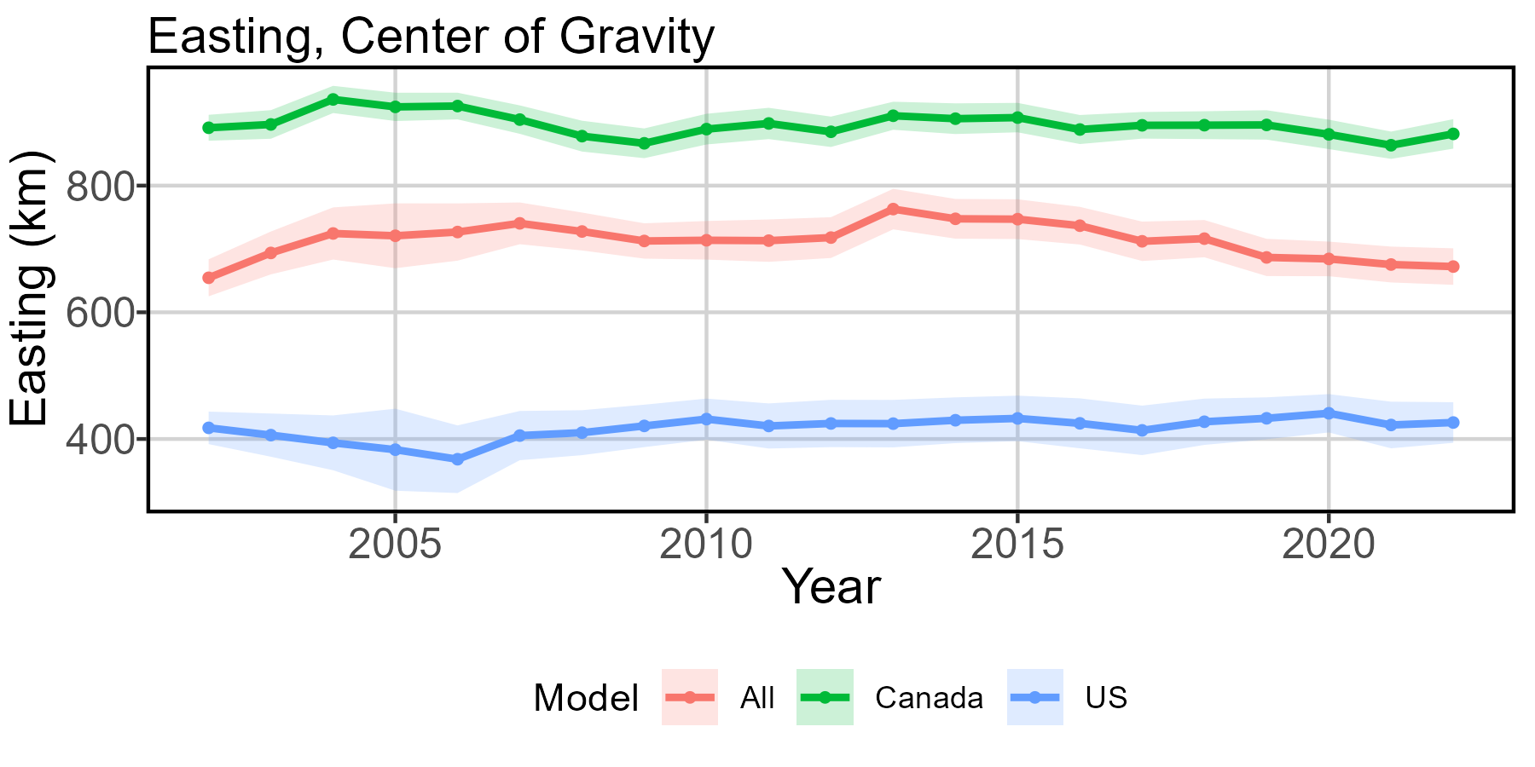
Center of gravity - strata

Slide 40
Distribution shifts

Slide 41
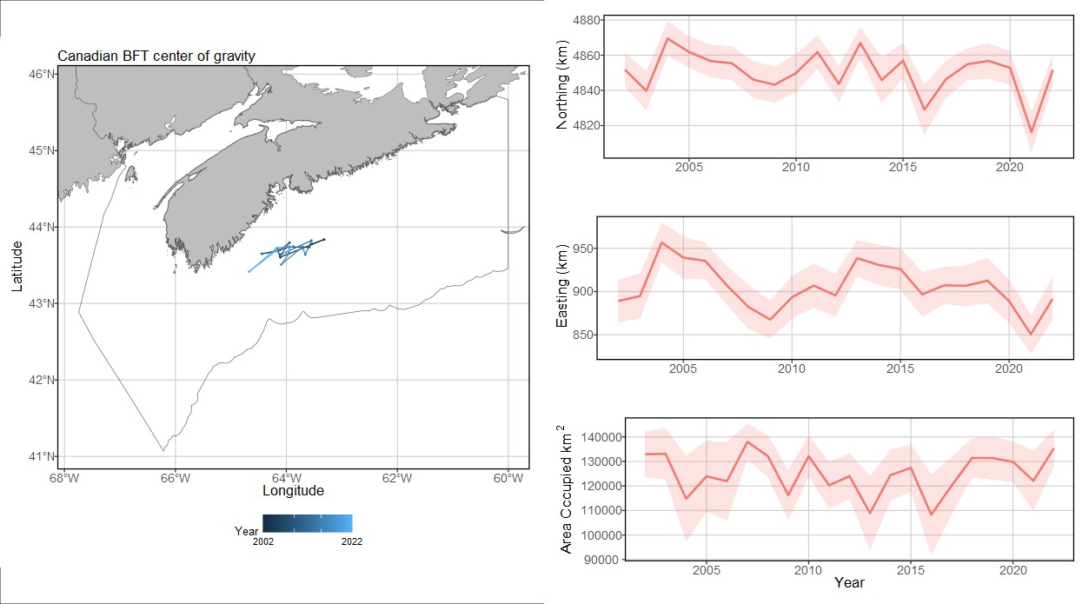
Distribution shifts

Slide 42
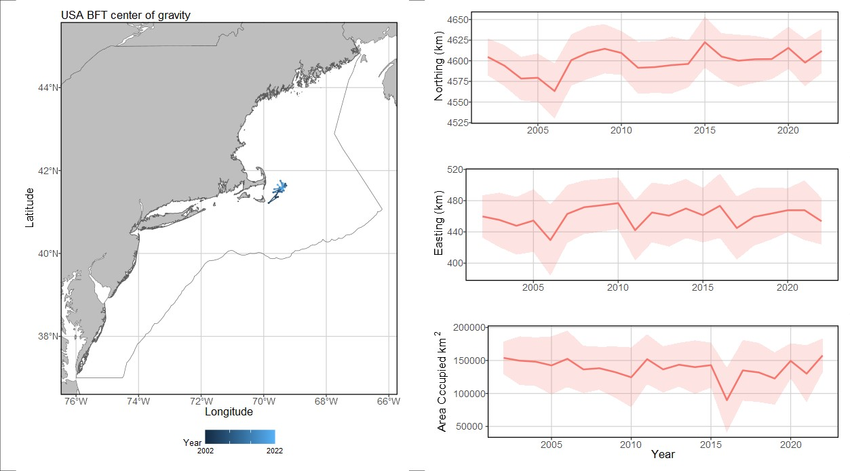
Distribution shifts

Slide 43
Center of gravity takeaways
Results
0.1 km/ yr SOUTH and 0.6 km/ yr WEST overall, 1.8 km/ yr north and 1.9 km/ yr east for US strata, 0.8 km/ yr SOUTH and 1.4 km/ yr WEST for Canadian strata.
Ecological meaning
From the joint (combined strata) model, looks like a few distinct eras here: move northeast from 2002-2009ish, stagnation 2010-2012, rapid jump northeast in 2013, move southwest 2014-present.
Historically, NS coast and shallows around the Northeast Channel (Georges and Brown Banks) have been the most productive areas. The southwestward shift of COG since 2014 is driven by increased estimated abundance on the Georges Side.

Slide 44
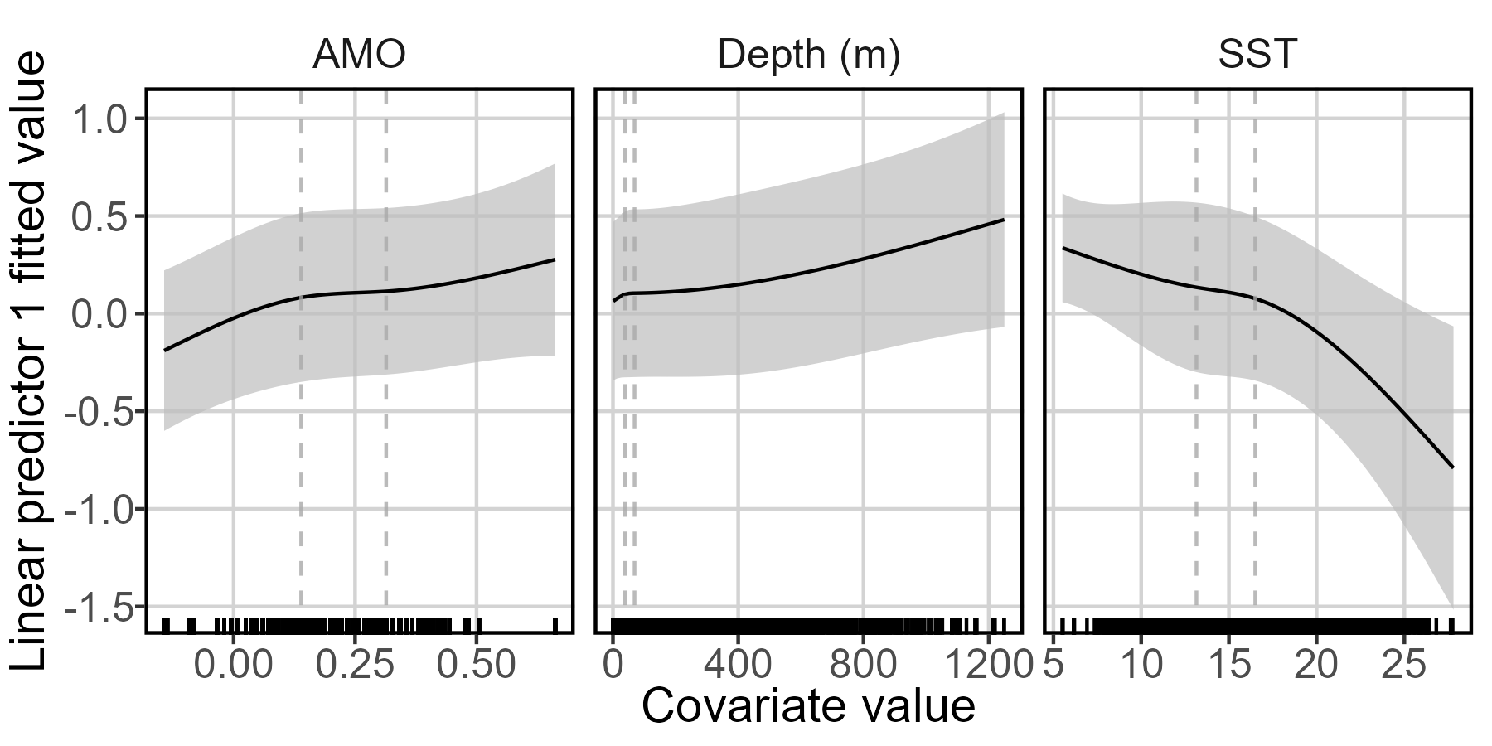
Density Covariate Marginal Effects – Presence/Absence
Notes:
Dashed vertical lines are where internal knots are placed (0.33, 0.66 quantiles).

Slide 45
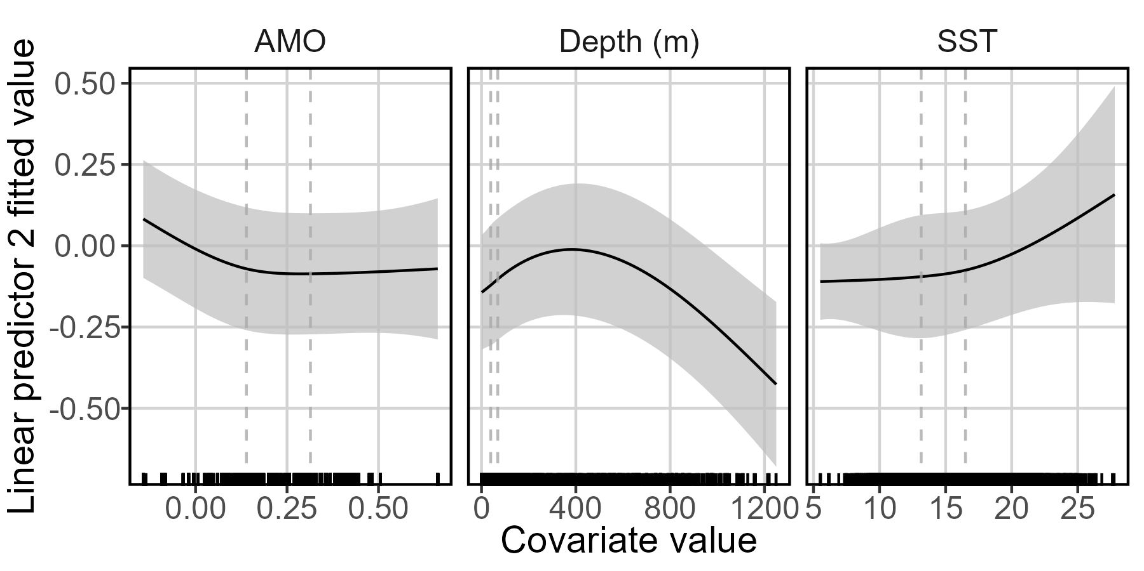
Density Covariate Marginal Effects – Positive catch rate
Notes:
Dashed vertical lines are where internal knots are placed (0.33, 0.66 quantiles).

Slide 46
Density covariate marginal effects takeaways
Marginal effects not assessed in previous model (new feature)
Ecological meaning
High SST translates to low probability of encounter, but weirdly also high positive catch rate. So, they probably won’t be around, but if they are you’ll see a lot of them.
AMO has a little more of an effect here than the US only model, with increasing strength of positive phase increasing encounter. No real effect on positive catch rate.
Depth is difficult to assess. Majority of the data are in waters less than 200m deep. There are many outliers up to 1200m. Relationship indicates increased presence with depth, but declining positive catch after around 400m.

Slide 47
Overall
Abundance
US indices of abundance match what we got in US-only model
Indices of abundance also match what was reported to ICCAT in Alex Hansell/ Alex Hanke’s last iteration of this modeling effort
Center of gravity
Noticeable northward shift 2002-2013, slow return to early 2000s center of gravity area. Would have affected availability to US fishers outside of the GoM.
Average annual center of gravity change is slight southwestward shift
Range shifts
Range edges and effective area occupied show habitat compression at southern edge.
Density covariates
Major driver is SST.
Canadian effort has shifted dramatically later into the year, which means average yearly SST encountered in the fishery hasn’t changed as much as seen in the more temporally-consistent American effort. But temperature in effort-heavy months (Sep-Nov) have increased.

Slide 48
Data storage and management

Slide 49
GitHub
Have GitHub repo, will add you as collaborator
Need time to re-run some models after I get Alex Hansell’s attention and fix some things, will upload new results
Have withheld uploading large VAST output .RData files
Have also withheld uploading confidential raw data
Can place both in a Google Drive for pickup if necessary
What output, if any, will you need besides VAST-generated indices of abundance?

